Slide 1
Blood test
Master : doctor Ketabi
Regulation by : mohammad amin Eghtesad

Slide 2
Clinical laboratory testing
Lab tests used frequently by DDS
CBC( complete blood count)
  Hemoglobin
  Hematocrit
  RBC, WBC
  Differential WBC

Slide 3
Clinical laboratory testing
Lab tests used frequently by DDS
Bleeding studies
  PT( INR): Prothrombin Time
  PTT ( INR): Partial Thromboplastin Time
  BT: Bleeding time
  Platelet count

Slide 4
Clinical laboratory testing
Lab tests used frequently by DDS
Fasting blood glucose ( 126 mg %) Hb A 1 C
Infectious diseases: HBV, HCV, HIV, other

Slide 5
Clinical laboratory testing
Lab tests used frequently by DDS
DDS should have a working concept of WNL( range)
Errors in testing
Clinical scenario MOST IMPORTANT!
May need to repeat test in light of clinical impression

Slide 6
Clinical laboratory testing
Lab tests used frequently by DDS
CBC : RBC
4.6 - 6.2 million /cc- male
4.2 - 5.4 million/cc- female
Erythrocytopenia=Decrease= Anemias Fe, B-12, folate, pernicious, sickle cell
Erythrocytosis= Increase= Polycythemia dehydration, infection-fever

Slide 7
Clinical laboratory testing
Lab tests used frequently by DDS
CBC : Hemoglobin ( Hb)
Oxygen-carrying capacity
13.5- 18.0 g/100cc - males
11.5- 16.4 g/100cc - females

Slide 8
Common Clinical Uses of CBC
CBC demonstrates
  Leukocytosis
  Microcytic anemia with elevated red cell distribution width
  Thrombocytopenia
  During MHD you will learn disease processes that cause these aberations and develop differential diagnoses for them
  Your skills in lab interpretion will develop as the course evolves and you work through your small group and lab cases

Slide 9
Clinical laboratory testing
Lab tests used frequently by DDS
CBC : Hematocrit ( Hct)
Volume of RBCs per 100 cc of blood
40 - 52 % - males
35- 47 % - females

Slide 10
Red Blood Cell Tests
Hematocrit (HCT): measures the % of blood volume taken up by RBC’s
Mean Corpuscular Volume (MCV): average volume (size) of RBC’s
Mean Corpuscular Hemoglobin (MCH):
amt/concentration of hgb in average cell
Platelets: help stop bleeding by forming clots. Low plt count: thrombocytopenia

Slide 11
Use of MCV Result
The MCV is important in classifying anemias
  Normal MCV = normocytic anemia
  Decreased MCV = microcytic anemia
  Increased MCV = macrocytic anemia

Slide 12
Hemoglobin
The hemoglobin concentration is a measure of the amount of Hgb in the peripheral blood, which reflects the number of red blood cells in the blood
  Hgb constitutes over 90% of the red blood cells
Decrease in Hgb concentration =
  anemia
Increase in Hgb concentration =
  polycythemia

Slide 13
Clinical laboratory testing
Lab tests used frequently by DDS
CBC : mean corpuscular hemoglobin ( MCH)
Average Hb content of each RBC
27-32 pg

Slide 14
Clinical laboratory testing
Lab tests used frequently by DDS
CBC : erythrocyte sedimentation rate ( ESR)= aggregated RBCs
WNL < 20 mm/hr.
Inflammation
Increase= tissue destruction

Slide 15
Clinical laboratory testing
Lab tests used frequently by DDS
CBC : WBC
5,000 - 10,000 / cc
Leukocytosis= increased WBC infection, RF, allergies, necrosis, exercise, pregnancy, stress, drugs, LEUKEMIA
Leukopenia= decreased WBC hypovolemia, early leukemia, drugs, radiation, blood dyscrasias

Slide 16
White Blood Cell Count
A count of the total WBC, or leukocyte, count in 1mm³ of peripheral blood
A decrease in the number of WBCs =
  Leukopenia
An increase in the number of WBCs =
  Leukocytosis

Slide 17
Clinical laboratory testing
Lab tests used frequently by DDS
CBC : differential WBC
Neutrophils( segmented) = 50-70% Neutrophils( band) = 0- 5%
Lymphocytes = 25-40%
Monocytes = 4-8%
Eosinophils = 1- 4%
Basophils = 0- 1%

Slide 18
Clinical laboratory testing
Lab tests used frequently by DDS
CBC : differential WBC
LEUKEMIAS
Acute lymphocytic( lymphoblastic) leukemia
Acute myelogenous leukemia
Chronic lymphocytic( lymphoblastic) leukemia
Chronic myelogenous leukemia

Slide 19
Clinical laboratory testing
Lab tests used frequently by DDS
CBC : differential WBC
LYMPHOMAS
Hodgkin’s, non- Hodgkin’s, Burkitt’s

Slide 20
Clinical laboratory testing
Neutrophilic leukocytosis: bacterial infections, inflammatory disorders, drug reactions, leukemia
Lymphocytosis: bacterial infections, viral infections, leukemia
Eosinophilic leukocytosis: allergic reactions

Slide 21
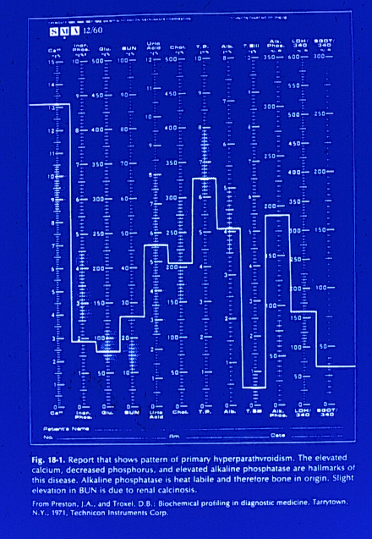

Slide 22
Clinical laboratory testing
BLOOD CHEMISTRY
SMA-12/60

Slide 23
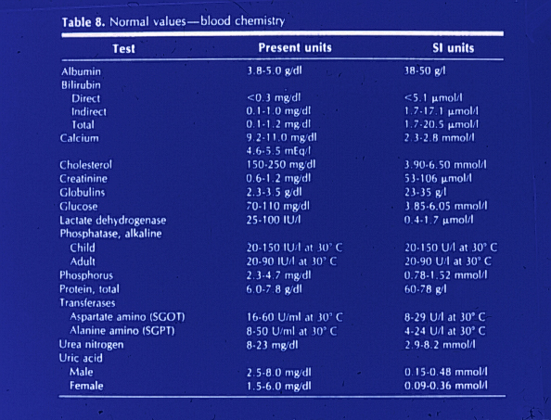

Slide 24
Clinical laboratory testing
BLOOD CHEMISTRY
BONE METABOLISM
Calcium, Phosphorous, Alkaline phosphatase

Slide 25
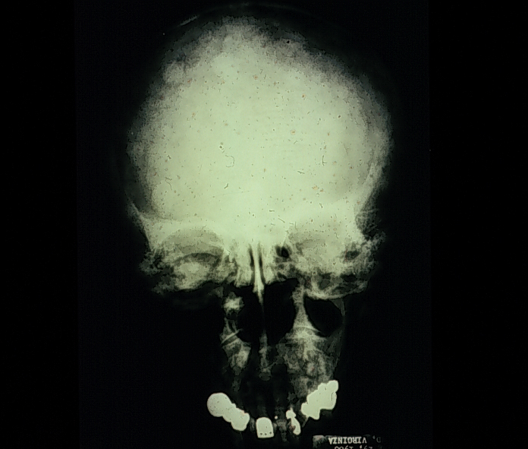

Slide 26
Clinical laboratory testing
BLOOD CHEMISTRY
BONE METABOLISM
Calcium, Phosphorous, Alkaline phosphatase
Hyperparathyroidism, Multiple myeloma
Paget’s disease, fibrous dysplasia
Osteoporosis , Cancer

Slide 27
Clinical laboratory testing
BLOOD CHEMISTRY
BONE METABOLISM
Calcium
9.0-10.5 mg%
Hypocalcemia: hypoparathyroidism, Vit. D deficicency, preganancy, diuretics

Slide 28
Clinical laboratory testing
BLOOD CHEMISTRY
BONE METABOLISM
Phosphorus
3.0- 4.5 mg%
Hyperphosphatemia: hypoparathyroidism, renal disease, hyperthyroidism, hypervitaminoisis D
Hypophosphatemia: hyperparathyroidism, malabsorption, Vit. D deficiency

Slide 29
Clinical laboratory testing
BLOOD CHEMISTRY
BONE METABOLISM
Alkaline phosphatase
25 - 115 Units/L
Elevated: hyperparathyroidism, Paget’s, sarcomas, metastatic carcinoma, growth

Slide 30
Sodium
Sodium is the major cation in the extracellular space where serum levels of approximately 140mmol/L exist
  Sodium salts are major determinants of extracellular osmolality.
Increased serum sodium level =
  Hypernatremia
Decreased serum sodium level =
  Hyponatremia

Slide 31
Potassium
Potassium is the major intracellular cation with levels of ~ 4 mmol/L found in serum
Elevated serum potassium level =
  Hyperkalemia
Decreased serum potassium level =
  Hypokalemia
*note – if a specimen is hemolyzed (such as by traumatic venipuncture or drawing blood with a needle that is too small) potassium levels may be “falsely” elevated. Why?
  There are high concentrations of K in red blood cells. If RBCs are lysed during phlebotomy, K is released into the serum resulting in elevated measured levels.

Slide 32
Chloride
Chloride is the major extracellular anion with serum concentration of ~ 100 mmol/L
Hyperchloremia and hypochloremia are rarely isolated phenomena.
  Usually they are part of shifts in sodium or bicarbonate to maintain electrical neutrality.

Slide 33
Carbon Dioxide Content
The carbon dioxide content (CO2) measures the H₂CO₃, dissolved CO₂ and bicarbonate ion (HCO₃) that exists in the serum.
Because the amounts of H₂CO₃ and dissolved CO₂ in the serum are so small, the CO2 content is an indirect measure of the HCO₃ anion
  Therefore, clinicians most often refer to the CO2 measurement in the BMP as the “bicarbonate level” or “bicarb level”

Slide 34
Blood Urea Nitrogen
The BUN measures the amount of urea nitrogen in the blood.
  Urea is formed in the liver as the end product of protein metabolism and is transported to the kidneys for excretion.
  Nearly all renal diseases can cause an inadequate excretion of urea, which causes the blood concentration to rise above normal.
  The BUN is interpreted in conjunction with the creatinine test – these tests are referred to as “renal function studies”.

Slide 35
Creatinine
The creatinine test measures the amount of creatinine in the blood.
  Creatinine is a catabolic product of creatine phosphate used in skeletal muscle contraction.
  Creatinine, as with blood urea nitrogen, is excreted entirely by the kidneys and blood levels are therefore proportional to renal excretory function.

Slide 36
Glucose
Plasma glucose levels should be evaluated in relation to a patient’s meal
  i.e., postprandial vs fasting
  Elevated glucose levels may also be indicative of diabetes mellitus
Glucose is the most commonly measured test in the laboratory

Slide 37
Diagnosing Diabetes
The criteria for the diagnosis of diabetes:
  Fasting Plasma Glucose ≥126 mg/dL
  2 hour Post-Prandial Glucose ≥200 mg/dl
  Random Plasma Glucose >200 mg/dL in the presence of symptoms
  Any one of these criteria must be repeated on subsequent testing of a new specimen

Slide 38
Total Calcium
The total serum calcium is a measure of both
  Free (ionized) calcium
  Protein bound (usually to albumin) calcium
Therefore, the total serum calcium level is affected by changes in serum albumin
  As a rule of thumb, the total serum calcium level decreases by approximately 0.8mg for every 1gram decrease in the serum albumin level.

Slide 39
BMP as reported by LUMC Lab in the EPIC EMR
Component Value Flag Low High Units
SODIUM 142 136 144 MM/L
POTASSIUM 3.9 3.3 5.1 MM/L
CHLORIDE 107 98 108 MM/L
CO2 27 20 32 MM/L
BUN 10 7 22 MG/DL
CREATININE 0.80 0.7 1.5 MG/DL
GLUCOSE 100 70 100 MG/DL
CALCIUM 8.5 L 8.9 10.3 MG/DL

Slide 40
Clinical laboratory testing
BLOOD CHEMISTRY
RENAL FUNCTION TESTS
BUN ( blood urea nitrogen)
Uric Acid
Creatinine

Slide 41
Clinical laboratory testing
BLOOD CHEMISTRY
RENAL FUNCTION TESTS
BUN ( blood urea nitrogen)
8-18 mg%
Uric acid
2.4-7.5 mg %
Increased: Chronic renal failure, chemo-Tx, lymphoproliferative disease, gout , acidosis

Slide 42
Clinical laboratory testing
BLOOD CHEMISTRY
RENAL FUNCTION TESTS
Creatinine
0.6-1.2 mg%
Increased: Chronic renal failure, CHF, acromegaly, dehydration, diabetes, shock

Slide 43
Clinical laboratory testing
BLOOD CHEMISTRY
LIVER FUNCTION TESTS
LDH: lactate dehydrogenase
AST: aspartate aminotransferase
ALT: alanine aminotransferase( SGPT)
Alkaline phosphatase
Bilirubin, Protein, Albumin

Slide 44
Clinical laboratory testing
BLOOD CHEMISTRY
LIVER FUNCTION TESTS
LDH: lactate dehydrogenase
50-240 Units/L
ALT
0-40 Units/L

Slide 45
Clinical laboratory testing
BLOOD CHEMISTRY
LIVER FUNCTION TESTS
LDH and ALT increased:
MI, liver disease, mononucleosis, renal disease, anemia, pancreatitis, skeletal muscle damage

Slide 46
Clinical laboratory testing
BLOOD CHEMISTRY
LIVER FUNCTION TESTS
Bilirubin
02.-1.5 mg %
liver disease: hepatitis, cirrhosis, drug toxicities

Slide 47
Clinical laboratory testing
BLOOD CHEMISTRY
LIVER FUNCTION TESTS
Total protein
5.6-8.4 g %
Albumin= 3.4- 5.4 g %
Globulins= 2.2-3.0 g %
liver disease: cirrhosis, chronic infections,
Multiple myeloma

Slide 48
Clinical laboratory testing
BLOOD CHEMISTRY
BLOOD GLUCOSE
70-100 mg %
Fasting > 126 mg % = diabetes
Increased : corticosteroids, catecholamines, growth hormone, CHF, diuretics

Slide 49
Clinical laboratory testing
BLOOD CHEMISTRY
SERUM CHOLESTEROL
<200 mg %
Elevated : hypercholesterolemia risk for ASCVD( MI)

Slide 50
Total Protein
Albumin and globulin constitute most of the protein within the body and are measured in the total protein test

Slide 51
Albumin
Albumin comprises ~ 60% of the total protein within the extracellular portion of the blood (Hgb is the most abundant protein in whole blood and is intracellular)
Albumin’s major effect within the blood is to maintain colloid osmotic pressure
  Transports many important blood constituents
    drugs, hormones, enzymes
Albumin is synthesized in the liver and therefore is a measure of hepatic function

Slide 52
Alkaline Phosphatase
(Alk Phos or ALP)
Alkaline phosphatase is an enzyme present in a number of tissues, including liver, bone, kidney, intestine, and placenta, each of which contains distinct isoenzyme forms
Isoenzymes are forms of an enzyme that catalyze the same reaction, but are slightly different in structure
The two major circulating alkaline phosphatase isoenzymes are bone and liver.
  Therefore elevation in serum alkaline phosphatase is most commonly a reflection of liver or bone disorders.
    Levels of alk phos are increased in both extrahepatic and intrahepatic obstructive biliary disease

Slide 53
Bilirubin, Total
The total serum bilirubin level is the sum of the conjugated (direct) and unconjugated (indirect) bilirubin.
  Normally the unconjugated bilirubin makes up 70-85% of the total bilirubin
Remember that bilirubin metabolism begins with the breakdown of red blood cells in the reticuloendothelial system and bilirubin metabolism continues in the liver
  Elevation in total bilirubin may therefore be a reflection of any aberrations in bilirubin metabolism or increased levels of bilirubin production (such as hemolysis)

Slide 54
Detection of the patient with bleeding problems
Prothrombin time( PT ) or International Normalized Ratio (INR)
Partial thromboplastin time (PTT)
Thrombin time (TT)
Bleeding time (BT)
Platelet count

Slide 55
Prothrombin time (PT)
activated by tissue thromboplastin tests extrinsic and common pathways
run with a control ( variable with lab : therefore: INR)
normal= 11-15 seconds
prolonged time = abnormal ( significant for dentistry > 2.5, 3.0, 3.5...)

Slide 56
Activated partial thromboplastin time (PTT)
Contact activator( kaolin)
tests the intrinsic and common pathways
run with a control
normal= 25-35 seconds
prolonged ( 2.5, 3.0, 3.5...)= abnormal

Slide 57
Thrombin time(TT)
activated by thrombin
tests the ability to form a solid clot
run with a control
normal= 9-13 seconds
prolonged( 2.5, 3.0, 3.5,...) = abnormal

Slide 58
Ivy bleeding time (IBT)
tests vascular and platelet status
Immediate factors in control of bleeding
normal = 1-6 minutes
abnormal = prolonged time

Slide 59
Platelet count
tests numbers of platelets present to form clot
normal= 140,000 to 400,000 / cc
bleeding problems < 50,000/cc

Slide 60
Platelet Count (PLT)
A count of the number of platelets (thrombocytes) per cubic milliliter of blood
  A decreased number of platelets =
    Thrombocytopenia
  An increased number of platelets =
    Thrombocytosis

Slide 61
Thrombocytopenia
platelet count ~ 50,000 ( with or without platelet replacement)
< 50,000 = bleeding problem

Slide 62
Bleeding disorders
Nonthrombocytopenic purpuras
  vascular wall alterations
  platelet function disorder
Thrombocytopenic purpuras
  Primary ( genetic)
  secondary( acquired: drugs, diseases)
Disorders of coagulation
  inherited, acquired

Slide 63
Microbiological exam
Sample collection ( bacterial, fungal, etc.)
Lesion
Transport media
Clinical information: site, nature, differential diagnosis
ID organism
Antimicrobial sensitivity : long-term Rx, diabetes, immunosuppressed, refractory to Tx
Closely follow course of TX

Slide 64
Thank for your attention
Any question ?

